Slide 1

AI App/ Project Name
User Manual
Author: David Olaoluwa Olaniran
Notes:
Preworks course home assignments

Slide 2
Table of Contents
• Acknowledgements
• About Me
• About My Internship with Clevered
• About the App
• How to Use the App
• Contact Details

Slide 3
Acknowledgements
I would like to thank everyone who made this journey possible. Firstly, I would like to thank my parents for giving me the opportunity to be part of such an enlightening internship. Secondly, I would like to thank Mr. Avishek for helping me throughout my app development process. He guided us all through the internship and made it a very fun experience.

Slide 4
About Me..
Student’s Photograph
Student’s Introduction
I am a student in SS1, focused on my academics and always working hard to improve. I enjoy learning, writing, and explaining things in a way that shows I understand them. I am an aspiring Robotic Engineer .

Slide 5
About My Internship Journey with Clevered..
The internship has been very collaborative and engaging. It has taught me a lot about neural networks, deep learning, and other aspects of artificial intelligence in general. All my mentors have been very responsive and have guided me with any difficulties I have faced till now. The app was a success, and in the process of making the app, I have gained a lot of valuable insight into artificial intelligence. I am very thankful to everyone for this great opportunity.

Slide 6
About App..
App’s Introduction
The home page has a upload image button and below it a detect button. First the user has to click the upload image button. On doing so, their file explorer will pop up, where they can choose to upload any JPG file. After uploading, the user clicks the detect button. On doing so, there will be a display below the detect button. It will display “The image contains fire”, if fire is detected in the image; or it will display “The image does not contain fire”, if there is no fire detected in the image. The image which the user has selected will also display alongside.

Slide 7
How do I use the App?

Slide 8
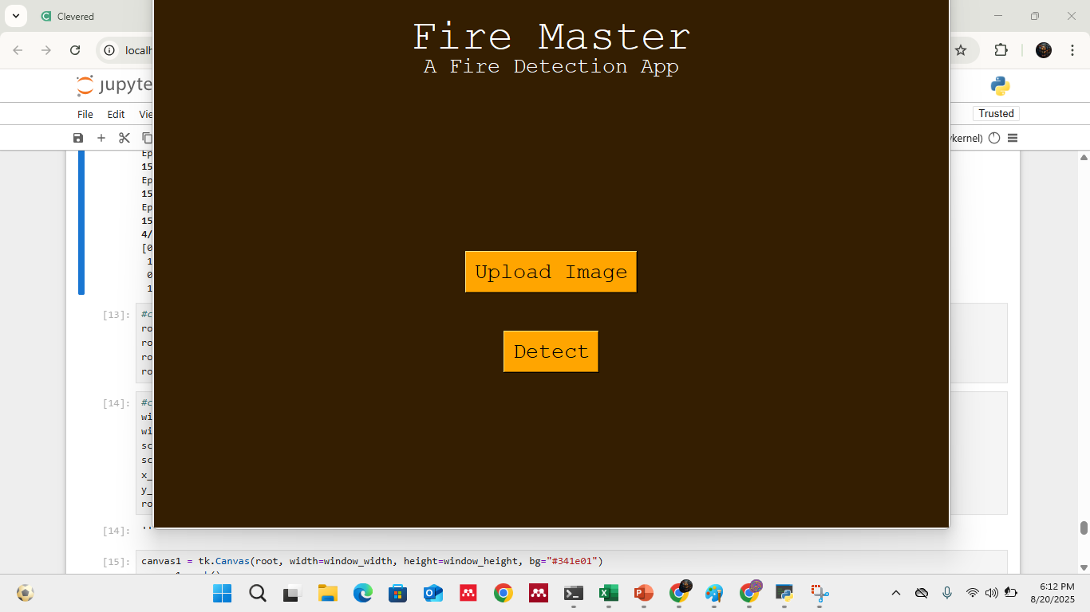
APP GUI

Slide 9
Contact Person
Please reach out to me at my email address: idjolaniran@gmail.com for any questions/ concerns/ suggestions on the App

Slide 10
Thank you!

